Slide 1






The Possibilities of Water on Mars
Name: Shreerang Mhatre
Rollno: 29
SY B.Tech Elec & Comp Engg

Slide 2


The Search for Water on Mars
For years, scientists have been searching for evidence of water on Mars. For decades, the presence of liquid water on the Red Planet has been a subject of heated debate and speculation. In recent years, however, evidence has mounted that suggests that water may indeed exist on Mars.
The search for water on Mars has been aided by the presence of spacecraft orbiting the planet. These spacecraft have been able to detect evidence of water in the form of ice, as well as evidence of water vapor in the atmosphere. This evidence has been used to support the hypothesis that liquid water may exist on Mars, as well as the possibility of life on the planet.

Slide 3
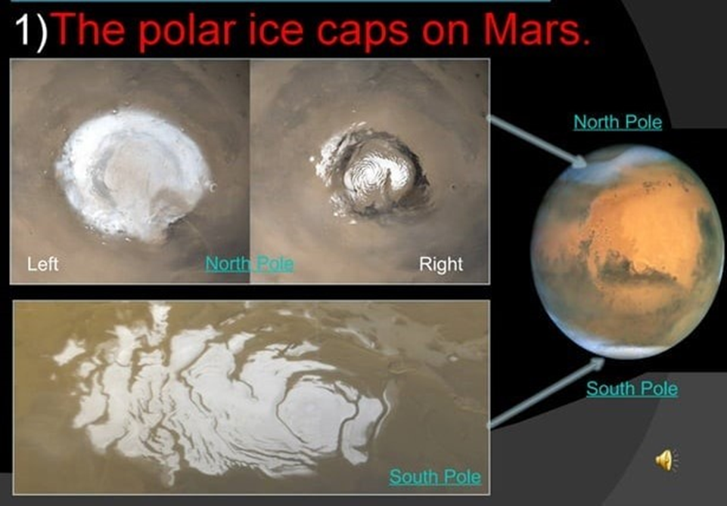

Slide 4

After Ice found on water everyone be like:

Slide 5
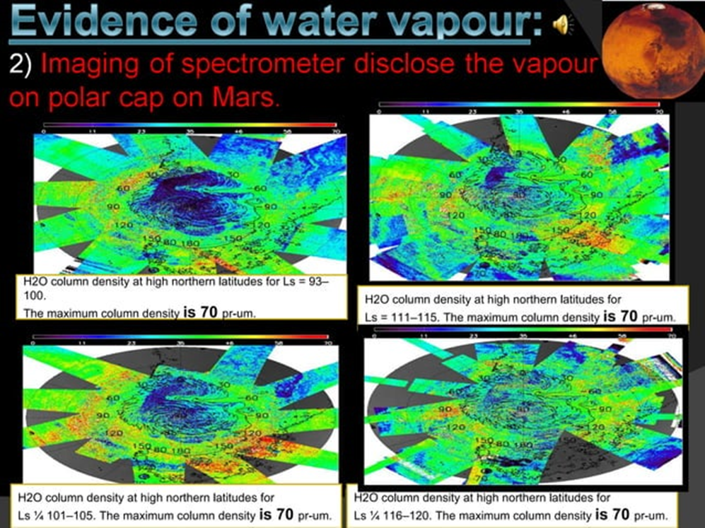

Slide 6



After Finding water on Mars

Slide 7
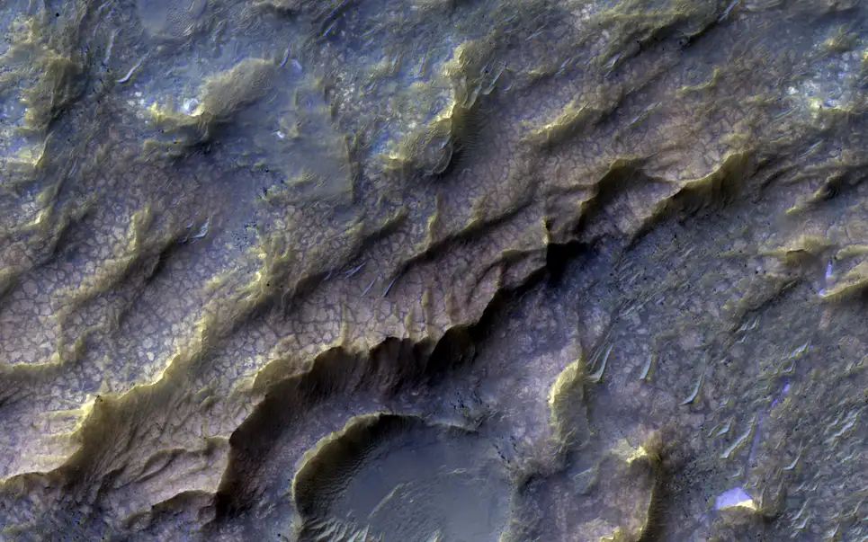
Mars’ ‘Dragon Scales’
The Mars Reconnaissance Orbiter of NASA snapped this picture of a distinctive ‘dragon scale’ pattern from Mars orbit. This arises from clay-bearing rock interacting with water, meaning the pattern likely formed billions of years ago.

Slide 8

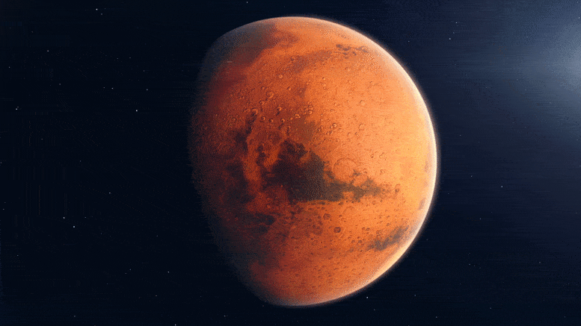
Just like on Earth, water on ancient Mars would have been a precious resource for any living thing. By studying it, we are uncovering the history of another world, preparing for future exploration, and potentially showing that we aren’t alone in the Universe.

Slide 9

After knowing about water on MARS:

Slide 10




THANKYOU
Name: Shreerang Mhatre
Rollno: 29
SY B.Tech Elec & Comp Engg

